Slide 1
Writing bible study Lessons
Rev. Dr. Rob A. Fringer

Slide 2
Thoughts as we begin
Writing is both rewarding and challenging; it takes discipline
Writing bible study lessons is important and potentially dangerous
This must be taken seriously and done prayerfully and with excellence

Slide 3
How to Start
Interpretation
  choosing a book or a passage of scripture to interpret
  The first step in Interpretation is exegesis (to lead out) – “What was the author trying to communicate to his audience?”
  The second step in interpretation is application – “How do we apply this interpretation in our own lives in our own context?”
Writing
  Once this has taken place, you may begin writing you Bible Study lessons, which will include a lot of the information you gained from the interpretation process

Slide 4
Learning to Faithfully interpret scripture
The first rule in interpretation is – The text has a voice!
Therefore we need to learn to be good listeners and good observers
The three worlds of the text
  The world behind the text – Author/historical/Background
  The world within the text – text/literary/interpretation
  The world in front of the text – reader/theological/application
IT is important to take all these into account when interpreting scripture

Slide 5
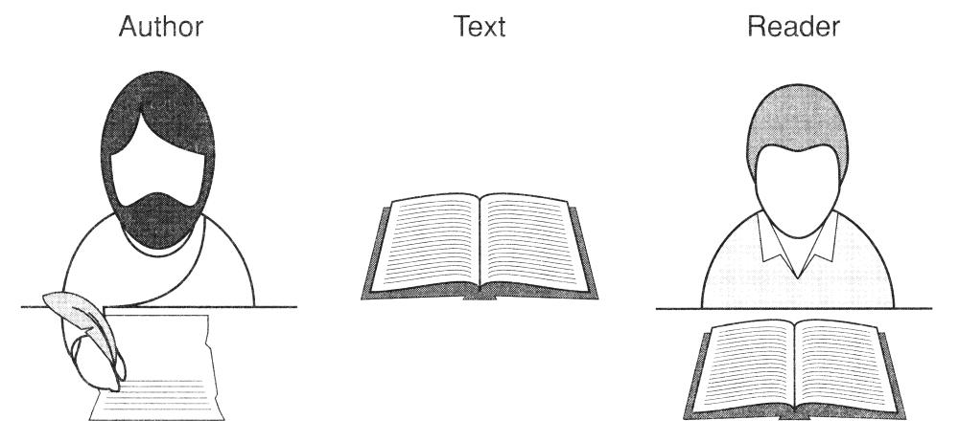
The three worlds of the text

Slide 6
A brief guide to interpreting scripture
Preliminary Work:
  Begin with prayer and asking the Holy Spirit to guide you as you read and interpret this passage.
  Read through the biblical book multiple time seeking to understand the main themes and the flow of the book.
  It is also good to state any presuppositions you have about your passage or about the book as a whole. This includes ideas you have heard from others through sermons, books, etc. Try to set these aside for the time being as they can often control/alter your interpretation.

Slide 7
A brief guide to interpreting scripture
The World Behind the Text: Historically Grounded Questions
  Who is the author and what do we know about him?
  Who is the audience and what do we know about them?
  When was this book written and what is important about this period for the author and audience?
  What is the overarching purpose/s of this book? (Why was it written?)
  Are there any other historical, cultural, or religious issues that need to be investigated further to help you understand the context of the author, audience, your passage, or the book as a whole?

Slide 8
A brief guide to interpreting scripture
The World Within the Text: Literary Grounded Questions
  What is the literary genre of the book? (e.g. narrative, poetry, law, gospel, etc.)
  Looking at the book as a whole, what are the major themes? (This is usually the strategy for fulfilling the purpose)
  Looking at the immediate context, the passage/s that come directly before and after your passage, do these passages help you understand your passage better?
  Are there repeated words, phrases, or ideas in your passage, the immediate context, or the whole book? How are they connected?

Slide 9
A brief guide to interpreting scripture
The World Within the Text: Literary Grounded Questions (cont.)
  Are there any biblical texts that are cited or clearly alluded to in your passage? (These can often be found in your Bible’s footnotes). What is the context of the cited text? Are there connecting words, themes, theological ideas? Can you determine why this text is being cited? (It is often used to [1] draw the reader into the previous story, [2] give support to the current argument, [3] provide an analogy).
  As you take all the above information into account, what are the key ideas in your passage? If a longer passage, consider dividing the text into an outline with sections. Give a short title to each section that encompasses the main idea of that section.
  How do these key ideas fit into the larger purpose the author is trying to fulfil in this book? Is it consistent? If not, is there another way of interpreting this passage?
  Create a “summary statement” that attempts to capture the main idea of the passage in your own words.

Slide 10
A brief guide to interpreting scripture
The World in Front of the Text: Theologically Grounded Questions
  How does your interpretation of this passage fit into the larger theological narrative of Scripture? Is it consistent? If not, is there another way of interpreting this passage?
  How does your interpretation of this passage fit into your own theological worldview? Is it consistent? If not, is there another way of interpreting this passage? Or, if not, do you need to re-examine any of your theological positions?
  What have others said about this passage? Is there anything that they have said that makes you need to re-examine your passage in light of this new information?
  What are the theological implications of your interpretation of this passage? (What does it teach you about God, God’s plan, humanity’s role?)
  What are the practical applications of your interpretation of this passage? What are some steps that can be taken to live out this truth in your context?

Slide 11
Writing
Key Idea (Title) - Having moved through the interpretation process, you now have the key idea (Your ‘summary statement’) for your bible study lesson. From this statement, create an appropriate title for your lesson
Lesson Goals - state the Lesson Goals, which are based on your key idea and the application of your interpretation. These are very important because they are guiding the reader toward what you are trying to accomplish.

Slide 12
Example
Title: The Holiness of God
Scripture Focus: Revelation 4:1-11
Key Idea: John’s glimpse into the throne room of God reveals the depths of God’s holiness and challenges us to respond in deep worship.
Lesson Goals:
  To understand the history and symbolism in the text
  To grasp the holiness of God
  To live out the reality of God’s holiness in tangible acts of worship

Slide 13
Writing
Introduction - provide a short introduction. For a bible study lesson, this introduction should include background information that helps provide context for your reader (World Behind the Text)
Body - move through the outline of your text that you created (world within the text).
  This is the place for you to describe what is going on in the text and what they author is trying to communicate.
  Make sure to address tricky or difficult concepts.
  You need to guide your reader through the text toward the key idea and lesson goals

Slide 14
Writing
Provide a conclusion that summarises your interpretation and captures the key idea and lesson goals.
Reflective Questions and Activities
  Keep your lesson goals front and centre in these questions and activities
  Questions should be geared toward wrestling with the passage at a deeper level and toward personal and contextual application
  Don’t ask yes or no questions or ones that can be easily answered with a single word
  Activities should help illustrate difficult ideas and/or provide a tangible way for the reader to take steps toward applying this teaching in there everyday lives.
  Make sure to include some type of reflection time on the activities

Slide 15
Important things to remember
This whole process should be bathed in prayer as you seek the Holy Spirit’s guidance.
Know your audience.
Write at a level appropriate to your audience.
Don’t use over-complex sentences. Simple is usually better and helps assure you are communicating your key idea.
Don’t lose sight of your key idea and your lesson goals. As you re-read through your lesson ask yourself if each sentence is helping to reinforce these things. Do the same with your questions and activities.

