Slide 1
Developing Missional Disciples: Partnering in God’s Redemptive Mission
Mark A. Maddix, Ph.D.
Northwest Nazarene University

Slide 2
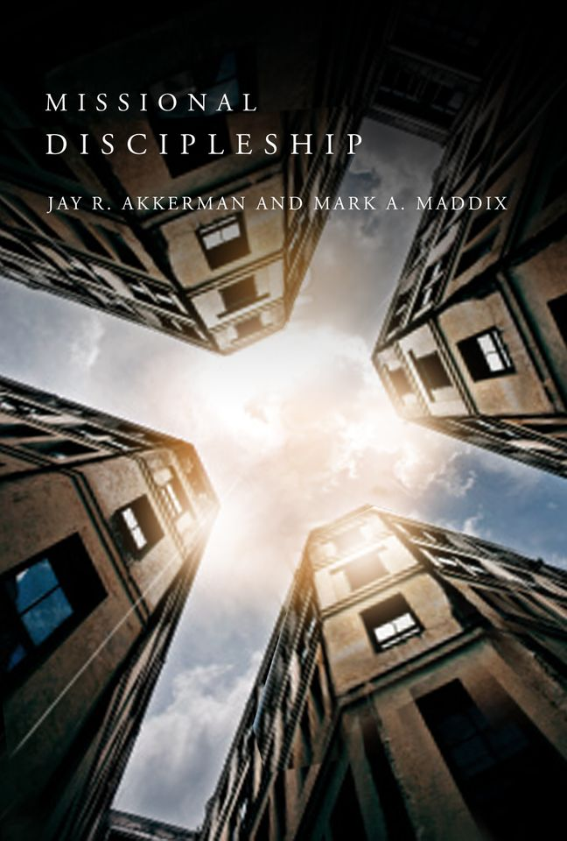
New book being released from NPH in Fall 2013
Missional Discipleship: Partners in God’s redemptive mission.
Mark A. Maddix & Jay Richard Akkerman, editors

Slide 3
Discipleship Approaches
Catechesis (education)
Spiritual Formation (spiritual growth)
Mentoring (personal discipleship)
Missional Engagement (witness)

Slide 4
Evangelism and Discipleship
Not Evangelism then Discipleship, but discipleship is the entire process of Christian witness.
A person’s faith is being formed and shaped before the decision of faith. Discipleship is the process by which persons are seeking God.

Slide 5
Missional Theology
The very heart of the Triune God is mission, missio dei.
“As the Father send me, so I send you” (John 20:21).
God sent Jesus to redeem all of humanity and creation, and now he sends the Church to partner in the restoration of all things.

Slide 6
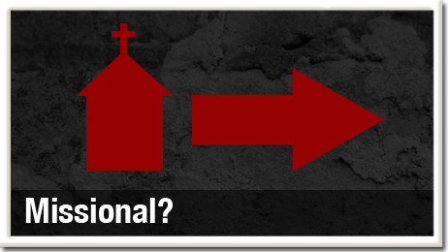
Missional Theology
The Church’s very nature is mission, primarily because God’s nature is mission.
The nature of the church is seeking and following where God is already active in the world.

Slide 7
Missional Discipleship
The nature of God is mission, the role of the church is forming disciples as we engage in missional practices that usher in the Kingdom of God (Maddix, 2013).
Wesleyan view of Prevenient Grace
  God is already at work in every persons life.
  God is working through all of creation.
  No separation between the secular and sacred.

Slide 8
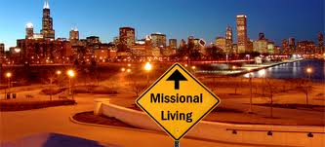
Missional Discipleship
“Missional Discipleship represents the missionary nature of the Triune God with the purpose of forming congregations to embody the gospel and to equip Christians to participate in the restorative and redemptive mission of God in the world” (Maddix, 2013)

Slide 9
Missional Discipleship
A missional discipleship is someone who is engaged in God’s mission in the world.
Missional disciples reflects someone who is on the journey, of becoming more like Christ, and embodying a life of love.

Slide 10
Missional Discipleship Practices
Less about belief and more about practicing faith.
  Incarnation versus Excarnation-a faith that lives more in the head than in the heart.
Belonging, belief, and behavior.
We follow the life of Jesus as the “way” of salvation.
Missional practices is the heart of faithful discipleship.

Slide 11
Mission begins “within”
Missional communities begin be recognizing that mission first begins within the church before the church can be God’s witnesses to the world.
As the church encounters the renewing love of God in the communal worship of Scripture, prayers, offering, and the Eucharist, it is transformed to proclaim hope and forgiveness to be God’s flesh and blood to the world (Maddix, 2013).

Slide 12
Inside-Out and Outside-In
A missional disciple moves from the inside out.
“If the gospel isn’t transforming you, how do you know it will be transforming anything else?” N. T. Wright
Spiritual discipleship is how we are transformed from the “inside-out,” but missional discipleship also focuses on “outside-in.”

Slide 13
Missional Discipleship
“Missional discipleship is an attentive and active engagement of embodied love for God and neighbor from the inside out” (Helland and Hjalmarson 2011, 27).
Discipleship is not only for us, but for the sake of others (mission).

Slide 14
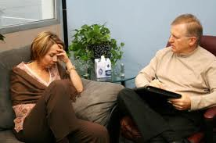

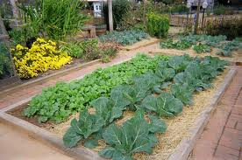
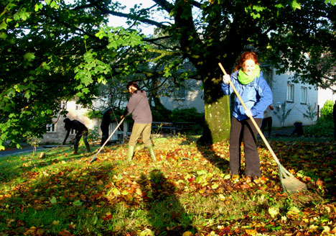



Slide 15
Missional Discipleship Practices
1. Misional Contextualization-the practice of embodied presence in the community.
  Christians are to enter their neighborhoods, restaurants, supermarkets, doctors’ offices, schools, where broken and needy people live, and where Christians can be Jesus for them. It is through this embodiment of life, that Christians participate in the reign of God (Maddix, 2013).
  Theology of Place-being open to see our neighborhood and community as where God has placed us to serve
  “glocal”-local and global

Slide 16
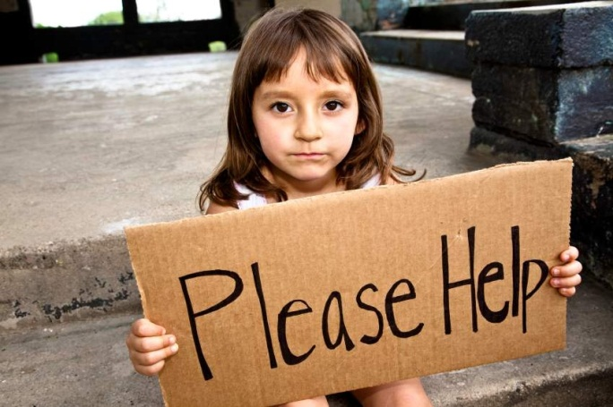
Missional Discipleship Practices
2. Hospitality-Missional discipleship begins with simple acts of hospitality by inviting people to gather and to engage in service.
  Willingness to cross borders and to be placed in uncomfortable situations with the marginalized of society (Maddix, 2013).
3. Acts of Compassion, Justice,
and Mercy-Missional discipleship
includes being concerned about
the injustices of society (Micah 6:8)

Slide 17
Missional Discipleshp Practices
4. Cross-Perspectival Dialogue-engaging in dialogue with those with differing views, religious ideas, and political perspectives.
  Provides opportunities for spiritual conversations about how God is working in the world and their lives.
5. Hospitality-inviting people regardless of their social or cultural context to be part of our community (Example of Zacchaeus).

Slide 18
Missional Discipleship Practices
6. Redemption of All of Creation-If we are going to reach our communities with the gospel we have to show them we care about the world.
Mark 16:15, “Go into all the world and proclaim the gospel to the whole creation.”

Slide 19
Missional Discipleship Practices
7. Freedom from Bondage and Oppression. The mission of Jesus was to preach the good news to the poor, to free the prisoner, to make the blind see, and to release the oppressed.
“The Spirit of the Lord is on me, because he has anointed me, to proclaim good news to the poor. He has sent me to proclaim freedom for the prisoner and recovery of sight to the blind, to set the oppressed free, to proclaim the year of the Lord’s favor” (NIV). Luke 4:18-19 (Isaiah 61:1-2)

Slide 20
Summary
A holistic view of discipleship includes evangelism as witness.
As Christians gather for worship we are equipped through the “means of grace” to engage in God’s mission in the world.
As missional disciples we recognize that God is working in all aspects of the world.
As we engage in missional practices we restore, renewal, and redeem persons and all of creation.

Slide 21
Akkerman, Jay R. and Mark A. Maddix. 2013. Missional Discipleship: Partners in God’s Redemptive Mission. Kansas City, MO: Beacon Hill Press.
Connor, Benjamin T. 2011. Practicing witness: A missional vision of Christian practices. Grand Rapids: Eerdmans Publishing
Hirsch, Alan and Debra. 2010. Untamed: Reactivating a missional form of discipleship. Grand Rapids: BakerBooks.
Guder, Darrell L., ed. 1998. Missional Church: A vision for the sending of the Church in North America. Grand Rapids: Wm. B. Eerdmans Publishing Company.
Helland, Roger and Leonard Hjalmarson. 2011. Missional spirituality: Embodying God’s love from the inside out. Downers Grove, Illinois: InterVarsity Press.
McNeal, Reggie. 2011. Missional communities: The rise of the post-congregational Church. San Francisco: Jossey-Bass.
Newbigin, Lesslie. 1989, The Gospel in a pluristic society. Grand Rapids: Wm. Eerdmans.
Roxburgh, Alan J. and M. Scott Boren. 2011. Introducing the missional Church: What it is, Why it matters, How to become one. Grand Rapids: Baker Books.
Van Gelder, Craig. 2007. The ministry of the missional church: A Community led by the Spirit. Grand Rapids: BakerBooks.

Slide 22
New book being released from NPH in Fall 2013
Missional Discipleship: Partners in God’s redemptive mission.
Mark A. Maddix & Jay Richard Akkerman, editors

Slide 23
Contact Information
Mark A. Maddix, PhD
Northwest Nazarene University
mamaddix@nnu.edu

