Slide 1
Best Practices of strong and effective governing boards
SEPTEMBER 2019
KOREA NAZARENE UNIVERSITY
Board of Trustees

Slide 2
GoalS FOR THIS SEMINAR . . .
REVIEW strategically the roles and responsibilities of the KNU Board,
AFFIRM Board “best practices,” and
IDENTIFY the goals and action steps necessary for the Board to lead the university successfully into the next phase of university life.

Slide 3
University Boards evolve and change as the
Educational institutions grow and mature.
If Not, then…

Slide 4
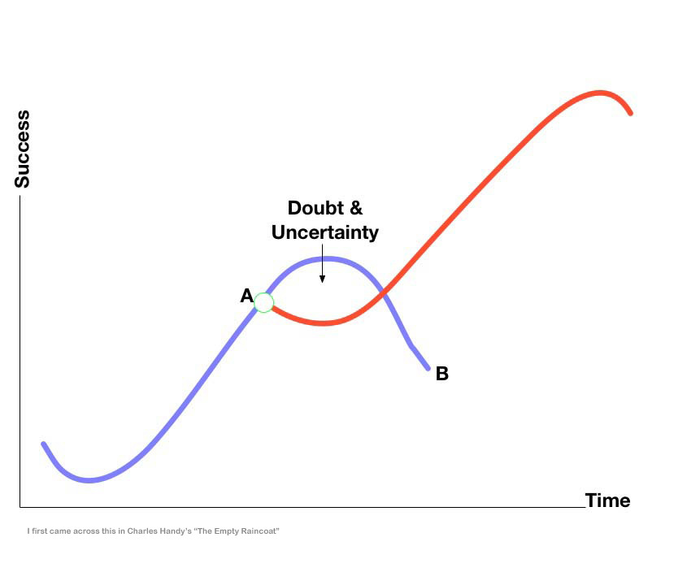

Slide 5
Working Assumption:
Strong governing boards
empower outstanding leaders.
Strong leaders
embrace engaged boards.

Slide 6
Best Practices of governing boards…

Slide 7
What is a
“governing”
board?

Slide 8
Definitions
(www.thefreedictionary.com)
Noun
1. governing board - a board that manages the affairs of an institution
2. board of trustees - a governing board elected or appointed to direct the policies of an educational institution
3. regent, trustee – a member of a governing board

Slide 9
Who is
the KNU
Board of Trustees
and what does the Board do?

Slide 10
Characteristic #1
Board members
understand the role,
purpose and function
of the board,
including board structure

Slide 11
Head IN – FINGERS OUT
Best Practice:

Slide 12
Effective Governing Boards …
focus on policy formation
and mission strategy;
Not on daily operations
and personnel management.

Slide 13
1a. Four “Modes of Thinking” on Boards
Fiduciary mode:
1. Steward of tangible assets.
2. Develops university’s policies, values, and priorities.
3. Deploys resources missionally and wisely.
4. Ensures legal and financial integrity.
5. Approves academic programs consistent with university
mission, vision, and values.
Steward of long-term health and mission
accomplishments of the university.

Slide 14
Strategic mode:
1. Planning partner with the university president.
2. Drafts, updates, and reviews the mission
and strategic planning documents in light
of the mission of the university.
3. Proactive and intentional in strategic
planning for mission and vision fulfillment.
4. Ensures that a strategic plan is in place.

Slide 15
Representative mode:
  1. Comments and questions are rooted in
  KNU’s values, traditions, and beliefs.
  2. Problems are stated in light of history
  and heritage of the university.
  3. “How is the KNU ethos communicated
  through academic programs?” “Do our
  decisions violate the values of ‘our’ university?”

Slide 16
Reframing Mode:
1. Identifies the “big” picture, the “overarching”
issue or the “real” question.
2. Serves as a problem solver.
3. Re-envisions the situation with implications
for the future.
4. Restates the presenting problem in a
“big-picture” context.

Slide 17
1b. The board has governance and coordinating responsibility for institution wide:
Financial health
Academic integrity
Spiritual well being
of students
of employees
Strategic planning
(in consultation with national, regional,
and global church leadership, as appropriate).

Slide 18
1c. Board – university president relationship
The Board selects the university president to
implement the mission of the school
on behalf of the Board…
The president is the “eyes, ears, hands, and feet”
of the Board between board meetings.

Slide 19
1d. Board committees and agenda development
Effective Boards have a functioning executive committee and other appropriate committees for effective decision making.
Board agendas are developed to insure balance between leadership reports and time to deal with long term direction and progress.
Guard the agenda.

Slide 20
Characteristic #2
Board members
know, communicate, and
make decisions
in light of the university’s
mission, vision and values.

Slide 21
MISSION AND VALUES DRIVE US
Best Practice:

Slide 22
KNU Mission Statement:

Slide 23
KNU vision Statement:

Slide 24
KNU values Statement:

Slide 25
Realizing Our Intentions
“Always, the key question to be asked in Board decision making is:
Is this decision important for the long term survival, health, and mission achievement of our institution?
After answering this question, then policies and decisions can be made.”
Albert J. Meyer, author. p. 217

Slide 26
Characteristic #3
Board members
ask the
right questions

Slide 27
THINK QUESTIONS
Best Practice:

Slide 28

Board Members Ask The Right Questions
(mission-driven, value defining, facilitating and forward thinking…)
1. Who are we?
2. Where are we?
3. Where are we going?
4. How will we get there?
5. Why is it important to get there?
6. How will we know when we get there?

Slide 29
Basic on-going questions for KNU Board and university leadership:
Why did our constituents want to begin this college
(now university) in the first place?
Why does this university exist in 2019?
“Is this decision important for the long term survival,
health and mission achievement of our institution?”

Slide 30
1. Does KNU have a mission statement that
is known, owned, and repeated?
2. Has KNU marshaled the resources to
fulfill the mission?
3. Is KNU accomplishing it’s mission?
4. Can KNU marshal the resources to
continue fulfilling it’s mission?

Slide 31
Additional Board questions:
1. What should we be worrying about as a Christian
university?
2. What are we hearing that the KNU administration needs
to hear?
3. What are we thinking or dreaming about the KNU?
4. What are our concerns about KNU?
5. What can the district and local churches do to
better accomplish the mission of the university?

Slide 32
Characteristic #4
Board members
understand and embrace
a “Board Policy Manual” that contains the Board approved policies for effective and efficient governance of the university.

Slide 33
WRITE IT DOWN
Best Practice:

Slide 34
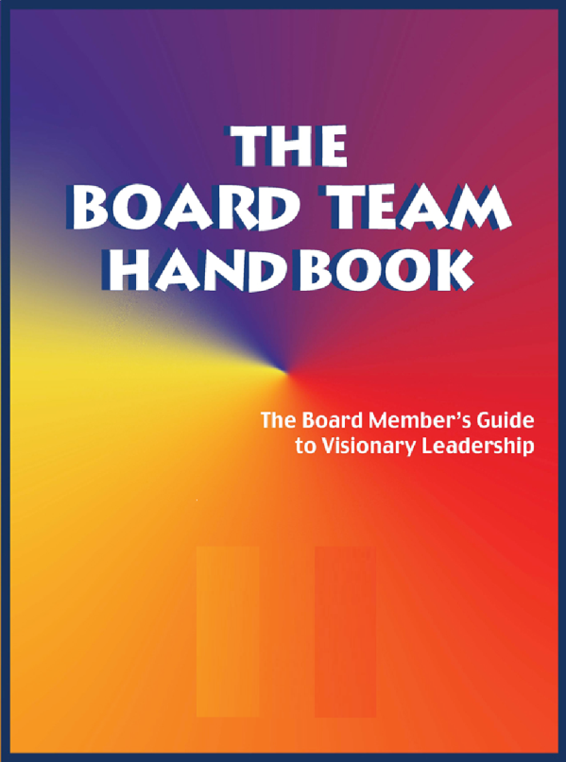
Board members understand and embrace a Board Policy Manual
that contains
the Board approved policies
for effective and efficient governance of the
university.

Slide 35
Board policies and procedures
are maintained in a notebook
that is provided for every
board member and updated
after each board meeting.

Slide 36
TEMPLATE
UNIVERSITY BOARD POLICY MANUAL
(Others are available)
A mission-driven, forward looking, value-defining and facilitating Board
Introduction
This Board Standing Policies Manual contains all the standing, or on-going, policies adopted by the Board of Trustees.
Reasons for Adoption. The reasons for adopting this evolving manual include:
1. Efficiency of having ALL on-going board policies in one place.
2. Ability to quickly orient new board members to current policies.
3. Elimination of redundant, or conflicting, policies over time.
4. Ease of reviewing current policy when considering new issues.
5. Clear, pro-active policies to guide the university president.
6. Models an approach to governance that sister institutions
may use.

Slide 37
I. Organizational Ends toward which we are working—Mission, Vision, Values
This section defines why we exist, for whom we exist, what we intend to contribute to those for whom we exist, and the priorities we assign to the benefits we provide to them.
II. Board Governance Process
This section defines how the Board will go about doing its work of governing the organization.
III. Board/President Relationship
This section defines how the Board will delegate authority and responsibility to the president.
IV. Executive Parameters
This section defines the parameters/limitations within which the president will work in accomplishing the task assigned to him/her.
*Based on writings of John Carver on Board Governance

Slide 38
Characteristic #5
Board members
communicate
with each other and
address conflict situations
as Christians.

Slide 39
WATCH YOUR WORDS
Best Practice:

Slide 40


Board members communicate
with each other Christianly (Eph. 4:2), compassionately,
respectfully,
directly,
and supportively.

Slide 41
A good university leader and board chair relationship is like a good marriage: it is based on mutual respect, trust, commitment, and effective communication.
Board members relate to the university president and the constituency with one voice.
The university constituency desires and expects a synergistic board and president partnership.

Slide 42

Vigorously discuss policy options and make decisions within the board meetings,
And communicate board action outside the board
meetings with
unified support.

Slide 43
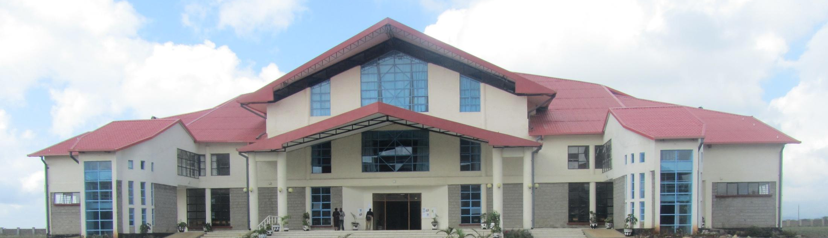
Characteristic #6
Board members listen to the constituency, appreciate the heritage of the university, and model faith development and spiritual formation.

Slide 44
Active representatives of the university
Best Practice:

Slide 45
Character Counts
Speak Gracefully.
Live Gratefully.
Listen Intently.
Forgive Freely.
Lead Decisively.
Care Deeply.
Pray Earnestly.

Slide 46
Characteristic #7
Board members
intentionally engage in
mutual accountability,
including systematic
board development and
evaluation.

Slide 47
INTEGRITY MATTERS
Best Practice:

Slide 48
Board Development Questions:
How does work of the board support the overarching mission and vision of the university?
In what ways have the initiatives of the board contributed to the numerical growth and spiritual development of the university?
How can the climate of collaboration between the board, district, administration with faculty and staff be enhanced?
What are the three top university challenges for the next year? What short-term and long-term goals have been established in light of these challenges?
Are the board’s short-term and long-term goals aligned with the institution’s strategic plan?

Slide 49
Characteristic #8
Board members
take time to
process decisions and
adhere to the practice of
“no surprises”

Slide 50
TAKE TIME
Best Practice:

Slide 51
The Board leadership and university leadership work together to plan, set agendas, and develop policy recommendations to the Board.
The KNU president is involved in any board development process, and the board chair is kept abreast of major developments in the university.

Slide 52
Characteristic #9
Board members
embrace change and resolve
to work through transitions
together and united for
the good of the Kingdom and the advancement of God’s mission

Slide 53
YES! TO VISION-INSPIRED CHANGE
Best Practice:

Slide 54
Characteristic #10
Board members
participate in assessing
the effectiveness of prior decisions and collectively make appropriate adjustments.

Slide 55
REVIEW - REVISE - RESTATE - RENEW
Best Practice:

Slide 56
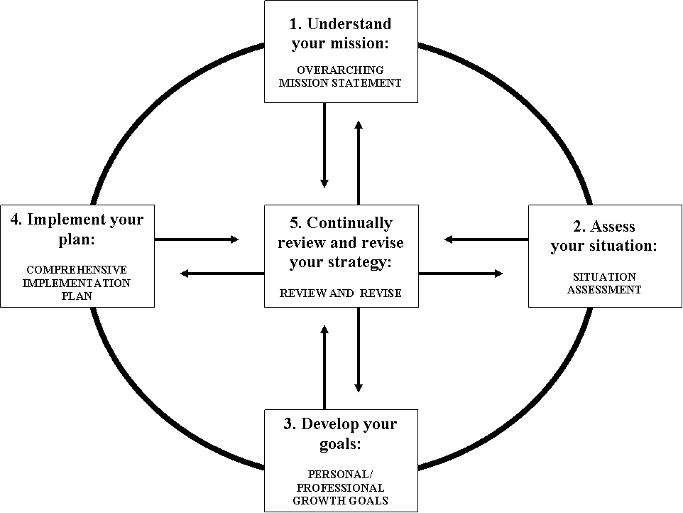
Planning Cycle

Slide 57
Characteristic #11
Board members
are outstanding examples
of giving regularly and sacrificially to the church and the university.

Slide 58
ROLE MODELS OF GENEROSITY
Best Practice:

Slide 59

Financial donors look first
to board members for evidence
of their consistent giving
to the university
-individually and collectively

Slide 60
Characteristic #12
Board members
develop new leaders
for increased responsibilities and commitment
to the organization.

Slide 61
PASS IT ON
Best Practice:

Slide 62
Board members develop
new leaders
throughout the country
for increased responsibilities
and commitment to
Korea Nazarene University.

Slide 63

Reproduce yourself
as a passionate advocate
for the university.

Slide 64
Use committees as a way to provide opportunities for emerging leaders to take on more responsibility.
Board leaders should intentionally mentor and nurture the next generation of leadership for KNU!

Slide 65
In Summary…
Processes to be clarified?
Policies needed?
Questions to be asked?
Plans to be developed?
Projects to be initiated?
Recommendations to the board chair?
Next steps?

Slide 66
Best Practices embraced:
HEAD IN – FINGERS OUT
MISSION AND VALUES DRIVE US
THINK QUESTIONS
WRITE IT DOWN
WATCH YOUR WORDS
ACTIVE REPRESENTATIVES OF THE UNIVERSITY
INTEGRITY MATTERS
TAKE TIME
YES! TO VISION-INSPIRED CHANGE
REVIEW-REVISE-RESTATE-RENEW
ROLE MODELS OF GENEROSITY
PASS IT ON

